Slide 1
Data Analysis of Attrition
Michael Olheiser (DDS Analytics)
August 15th, 2020

Slide 2
Outline
Introduction
Employee Survey
Job Specific Trends
Numerical Attributes
KNN Classification
Conclusions

Slide 3
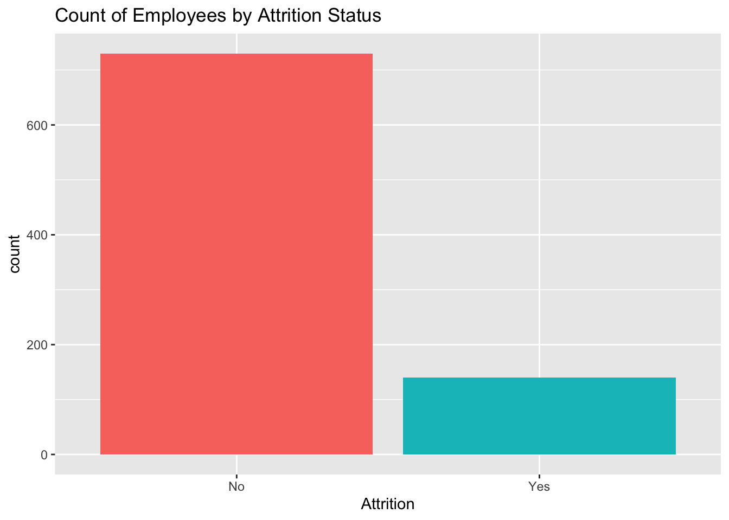
Introduction
870 employees of various job roles
13% Attrition
No Missing Values to deal with
Let's proceed!

Slide 4
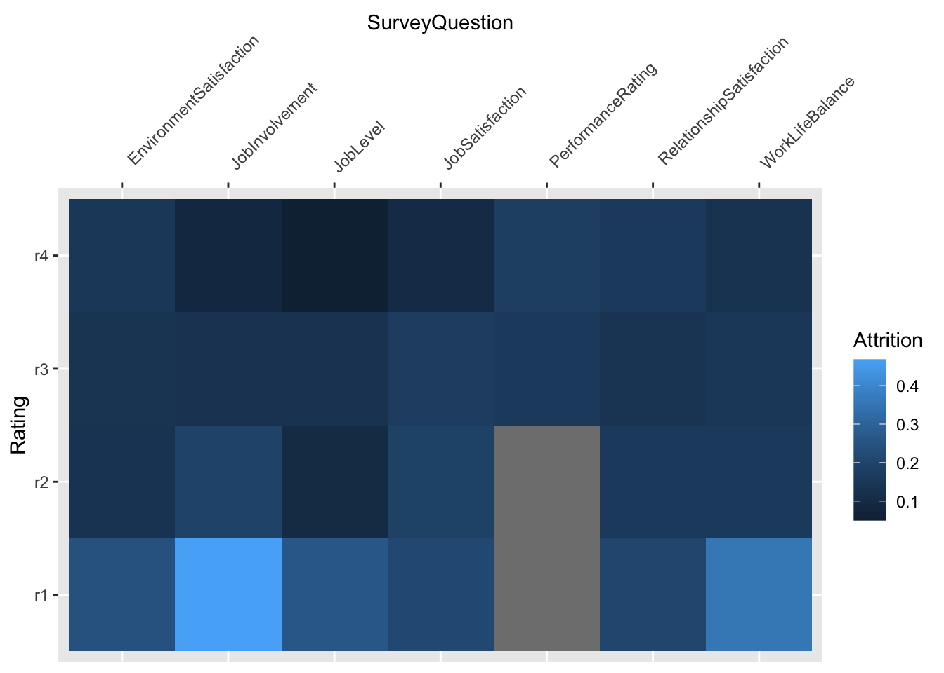
Employee Survey Results
Low ratings for Job Involvement and Work Life Balance are associated with higher turnover
Employees only rate themselves as 3 or 4.

Slide 5
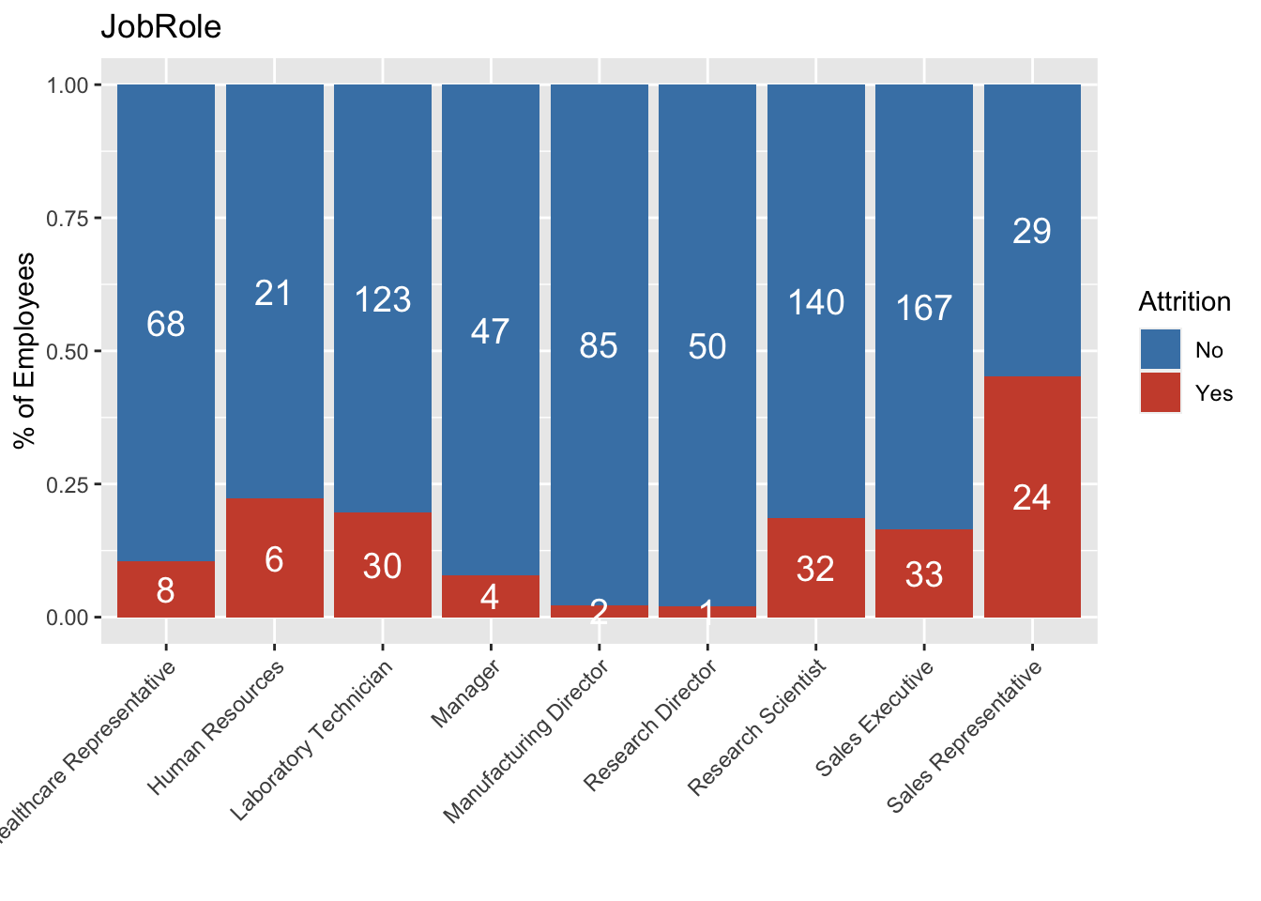
Trends in Job Roles
Sales staff appear to have higher turnover than other job roles

Slide 6
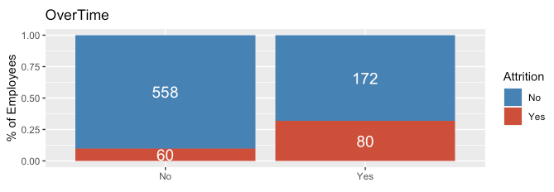
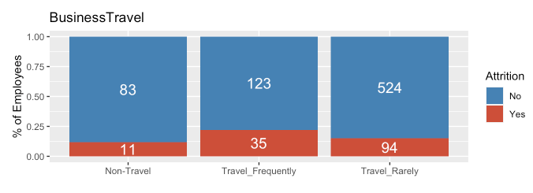
Job Specific Trends
Over time and frequent business travel may lead to employee turnover.

Slide 7
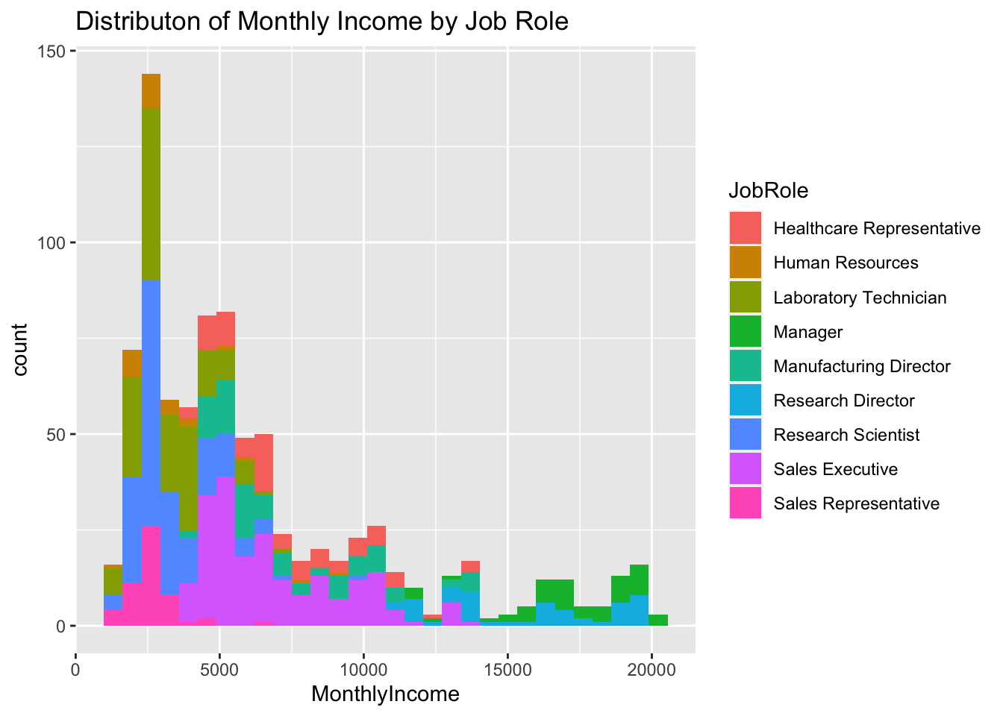
Job Specific Trends
Managers and Director earn more on average than Sales staff or HR

Slide 8
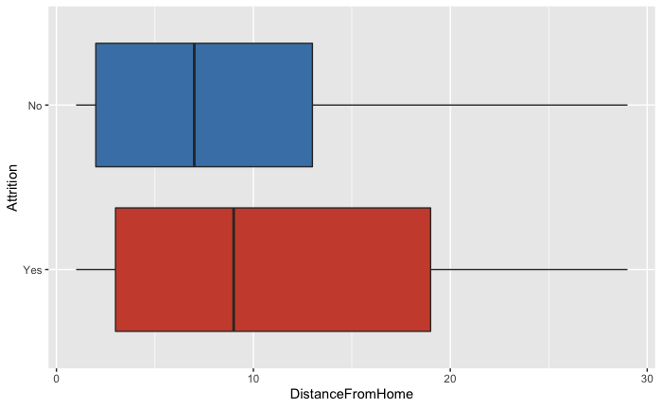
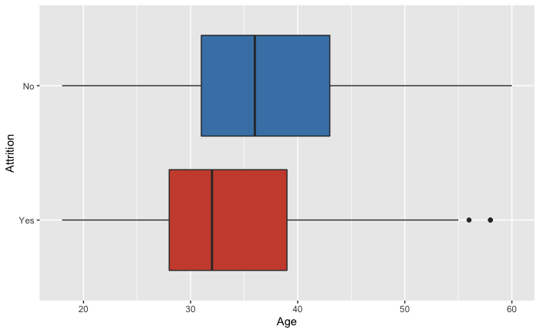
Numerical Attributes – Age and Commute
Box Plot of Distance from Home by Attrition
Box Plot of Age from Home by Attrition
Age correlates with experience and tenure at a company which is associated with lower attrition.
Long commutes may contribute to employee turnover

Slide 9
KNN Classification for Attiriton
K Nearest Neighbors or KNN provides a solution to predicting Attrition on other employees.
Our model uses Monthly Income, Job Involvement and Work Life Balance as predictors
KNN is particularly challenging to identify employees with Attrition.
Model | Accuracy | Sensitivity | Specificity
KNN for Attrition | 0.841954 | 0.8550296 | 0.4

Slide 10
Conclusion
Key attributes of Attrition
Work Life Balance
Job Involvement
Experience/Tenure
Job Specific Trends
Sales suffers from highest attrition among job roles
High travel and low income may lead to turnover.
Predicting Attrition
KNN is challenging to use due to small number of employees with turnover in data set.
More research needed to select a better model

